Slide 1
Guardians of the Network
Intro to IR

Slide 2
Welcome to Guardians of the Network
We will emulate incident response of the real world with lab scenarios
Real world != competition IR
Security is not a problem ONE person or ONE group can solve
We must come together as a community to solve the problem
We will create a community here
Icebreaker

Slide 3
Building a toolbox
Over the next two weeks we are going to lay down the foundation:
incident response mindset
attacker mindset
This foundation is going to create our toolbox
But we need tools to make our toolbox effective

Slide 4
You’re the tool
We are going to work in groups and with each other to grow everyone's toolset
1st year(freshmen)
Tools, Tactics, and Procedures (TTPs) time - 5 min presentation
2nd/3rd years
Presentation 10+ mins on a tool/topic OF YOUR CHOICE --- you can do in teams/partners
Red team challenges/scripting challenges
4th year +
Must present BUT you must work with an underclassmen(junior and below)
Everyone has their own unique way of tackling problems and I want everyone to share that.
Mine is not the best way but it’s MY way

Slide 5
What will be doing - “plan”
We will learn about what IR is and how to do it
We will learn about the attacker mindset and how they operate
Insert Sun Tzu quote
We will blue AND red team
Forensics
Hope to do:
SpaceJam is may be coming back and we can create our own logging platform
YOU will decide the tools we use
Memory forensics
Offensive coutner measures - internal honeypots and windows honey users
Incident response in a competition environment
Possibly have Kyle come in and talk about rootkits
Do some threat hunting
Discussion about security topics and news --- I will moderate
WHATEVER you and your peers wanna do --- This OUR group I am not the dictator

Slide 6

What is incident response?
Incident responders are the cyber detectives of the internet
Internet police - We did it reddit
Incident response - A term used to describe the process by which an organization handles a data breach or cyberattack, including the way the organization attempts to manage the consequences of the attack or breach (the “incident”)
Incident response is NOT about IF but about WHEN!!!

Slide 7
What are you trying to protect?
Assets
IT IS IMPOSSIBLE to determine your risk → which leads to managing it
IF you are NOT aware of what you have then you don’t know what you can lose.
Sun Tzu - Know thy self, know thy enemy. A thousand battles, a thousand victories.
WE have an idea of what the attackers are going for…
WE have an idea of their tactics….

Slide 8
Let’s protect our booty
Asset worth protecting?
User endpoints/client machines
5 year old e-mails
Credit card database
Employee e-mails
User’s hashed password
Employee parking lot/garage
Chrome extensions
Doors
Now let’s prioritize these items

Slide 9
Responsibilities of Incident responder
Scandalous email has been discovered on company devices/services
Empowering your users with knowledge
Determining the root cause of an issue and how to prevent recurrence
Includes detailed reports
Engaging stakeholders
Internal - third party services that you utilize
External - customers
Improving security
Being lovable <3
Security is about people

Slide 10
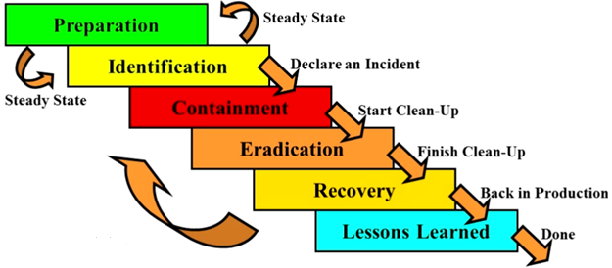
SANS incident response process

Slide 11
SANs incident response handbook
https://www.sans.org/reading-room/whitepapers/incident/incident-handlers-handbook-33901 READ THIS. READ THIS. READ THIS. READ THIS. READ THIS. READ THIS. READ THIS. READ THIS. READ THIS. READ THIS. READ THIS. READ THIS. READ THIS. READ THIS. READ THIS. READ THIS. READ THIS. READ THIS. READ THIS. READ THIS. READ THIS.

Slide 12
Scenario
We are BenAtCost which is a brand new startup on the internet.
BenAtCost is currently running a web store for customers to purchase services and swag.
Our dev’s are good guys but they believe security kills creativity.
:(
So tldr we have been pwned

Slide 13
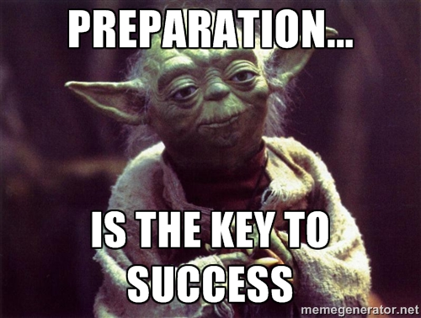
Preparation
This phase as its name implies deals with the preparing a team to be ready to handle an incident at a moment’s notice.
Policy
All employees are aware of computing policies
Response plan/strategy
Communication - PR and legal team
Documentation - playbooks
Team
Access Control - Firewalls and user permissions
Tools
Practice/Training
Simulate an attacker to see how the team responds
My spirit animal --->

Slide 14

Preparation - scenario
We didn’t prepare

Slide 15
Identification
TLDR - Determining if an event is an incident ( more on this in the next slide)
False positives - Detected as malicious but it’s not
Identification - This phase deals with the detection and determination of whether a deviation from normal operations within an organization is an incident, and its scope assuming that the deviation is indeed an incident. Gathering data from sources such as:
Log files
Error messages
IDS/IPS
SIEM
Firewalls

Slide 16
Event vs. incident
Event is an observable occurrence
Incident is an unacceptable act utilizing a digital asset

Slide 17
Event vs. incident
Event vs. incident
Event
An email
A phone call
A system crash
A request for a file to be scanned for malicious content
Incident
Violation of a policy
Attempts to gain unauthorized access
DDOS
Changes made to a system without the owner's consent

Slide 18
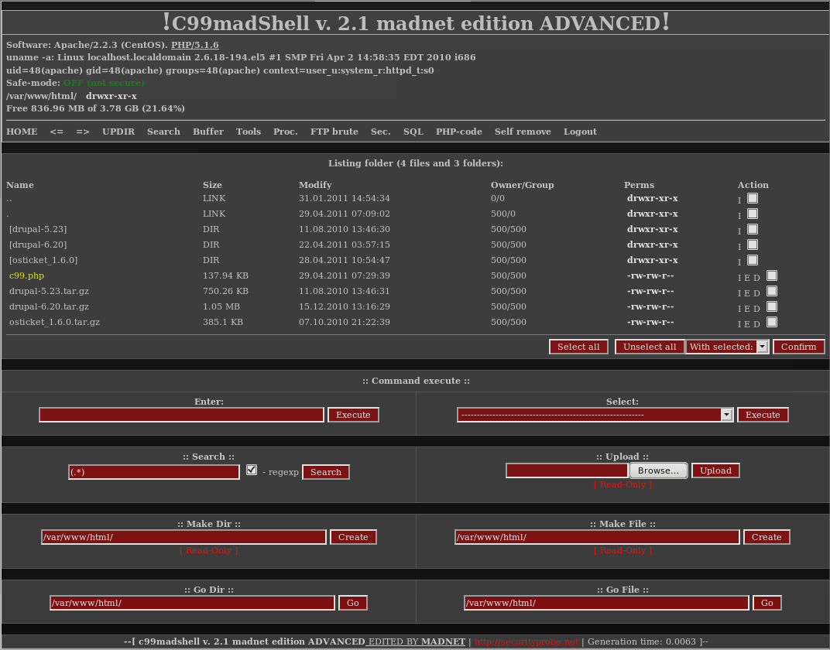
Identification - scenario
A database dump of users has ended up on PasteBin
So we know our web server has been compromised
In the /var/log/apache2/access.log we saw a user-agent of:
"Mozilla/5.00 (Nikto/2.1.6) (Evasions:None) (Test:Port Check)"
Real user agent: “Mozilla/5.0 (Windows NT 10.0; Win64; x64) AppleWebKit/537.36 (KHTML, like Gecko) Chrome/59.0.3071.115 Safari/537.36“
Next we see them accessing “uploads/c99.php
Famous web shell

Slide 19

Containment - short
The primary purpose of this phase is to limit the damage and prevent any further damage from happening.
Short-term containment
Can be simple
Isolating a network segment of infected workstations
Routing all traffic to failover servers
Not intended to be a long term solution to the problem; it is only intended to limit the incident before it gets worse

Slide 20
Containment cont.
System Back-Up
Before wiping/re-imaging a system, you must take a forensic image of the affected system(s) with known forensics tools
This preserves evidence and events from the incident and is used for observing how the system(s) were compromised during the lessons learned phase
If the infected machine is a VM take a snapshot of the current system. Store snapshot in a safe location for further analysis.
Tools: FTK, EnCase, DD, Clonezilla
Pro tip: Take hash of the forensic evidence!

Slide 21
Containment - long
Long-term containment
This is when we temporarily fix the affected systems so that they can be used again
Examples
Remove accounts and/or backdoors left by attackers
Install security patches on affected system(s) and neighboring systems
Disconnect and isolate systems from network
This will limit the spread of malware and reduce the number of affected systems
Basically any type of remediation that will allow normal business operations to continue

Slide 22
Containment - scenario
The CMO - Chief Meme officer said we CANNOT take our ONLY webserver offline
We take a live snapshot of the machine

Slide 23
Eradication
This phase deals with the actual removal and restoration of affected systems.
Defenses should be improved after learning what caused the incident and ensure that the system cannot be compromised again
Examples
Reimaging of system’s hard drives
Ransomware - Used by attackers to hide tracks
Determination has to be made if time and resources want to allocated to this incident.
Installing patches to fix vulnerabilities used by attacker
Disabling unused services to harden system
Scan affected system with anti-malware software to make sure malware is gone
Creating/downloading signatures for malware
Tools: YARA
Remove backdoor users or persistent mechanisms

Slide 24
Eradication - scenario
Fixing the code for files being uploaded.
Implement file integrity monitor
Check ‘/etc/passwd’ for new users

Slide 25
Recovery
The purpose of this phase is to bring affected systems back into the production environment carefully, as to ensure that it will not lead to another incident.
It is essential to test, monitor, and validate the systems that are being put back into production
Verify that they are not being reinfected by malware or compromised by some other means.
The length of this phase is done case by case.
If a known vulnerability is unfixable, detection capabilities should be put in place
Alerts should be created.

Slide 26
Recovery - scenario
We secured the box
We implemented security measures
This slide is left blank intentionally.

Slide 27
Lessons learned
The most critical phase after all of the others is lessons Learned.
The purpose of this phase is to complete any documentation that was not done during the incident, as well as any additional documentation that may be beneficial in future incidents.
When was the problem was first detected and by whom?
The scope of the incident.
How it was contained and eradicated?
Worked performed during recovery.
Areas where the IR team was effective.
Areas that need improvement.
The overall goal is to learn from the incidents that occurred within an organization to improve the team’s performance and provide reference materials in the event of a similar incident

Slide 28
Demo
Github repo:
https://github.com/CptOfEvilMinions/GuardiansOfTheNetwork
Demo readme.md -- Section “Incident reponse demo”
https://github.com/CptOfEvilMinions/GuardiansOfTheNetwork/blob/master/week1_dvwa/README.md
SSH into dvwa.hackinglab.beer
User: superadmin
Pass: PartyLike1969
docker exec -it dvwa_demo bash
For red team challenge and testing red team activity
dvwa.hackinglab.beer:8080
docker exec -it dvwa_pwn bash
Docker restart dvwa_pwn

Slide 29
Resources/Sources
Creating the InfoSec Playbook
SANs - Incident Handler’s Handbook
Windows: SANS Intrusion Discovery Cheat Sheet
Linux: SANS Intrusion Discovery Cheat Sheet
Powershell Event Manager Commands
Youtube - SANS DFIR Webcast - Incident Response Event Log Analysis

